Slide 3
Candle
Angel
Candy cane

Slide 4
Cracker
Card
Christmas tree

Slide 5
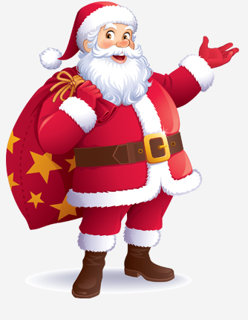
Father christmas
decoration
elf

Slide 6
present
fireplace
lantern

Slide 7
sleigh
pudding
reindeer

Slide 8
stocking
star

Slide 10
Christmas wishes
“Wish best wishes for Christmas and the New Year!”
“Wishing you every success for the New Year!”
“Wishing you a Christmas filled with love and friendship!”
“May your Christmas be filled with happy surprise!”
“Wishing you a Merry Christmas and a Happy New Year!”

